Slide 1
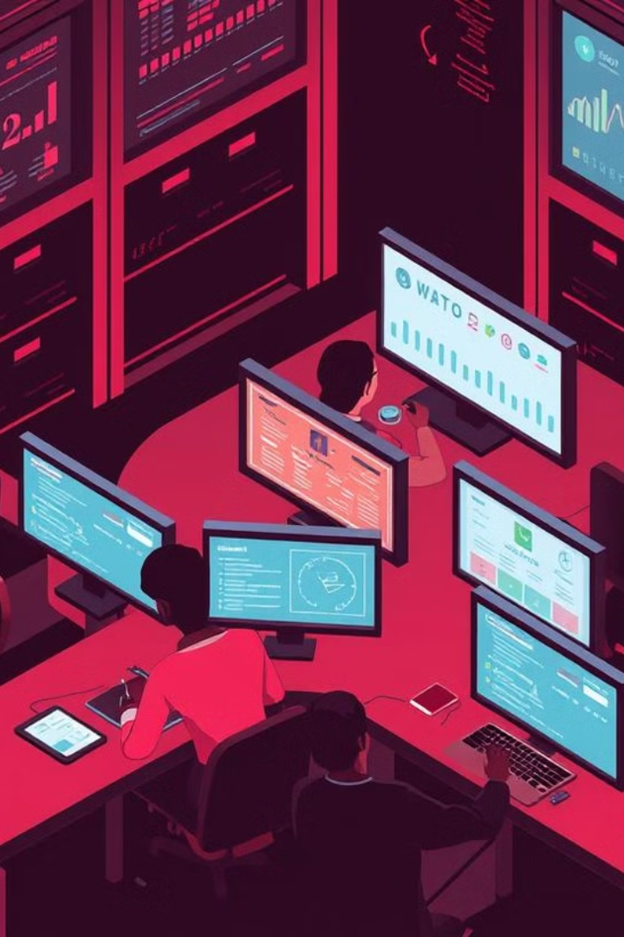
Sentiment Analysis: Understanding Customer Emotions
Unlocking insights from text. A journey into sentiment analysis.

Slide 2
Introduction to Sentiment Analysis
Sentiment Analysis (also known as opinion mining) is the process of using natural language processing (NLP), machine learning (ML), and computational linguistics to determine the emotional tone behind a piece of text. Essentially, it helps to understand whether the sentiment is positive, negative, or neutral.
It helps businesses and individuals understand opinions, emotions, and attitudes expressed in written language.
Widely applied in areas such as:
Analyzing customer feedback from reviews and social media.
Understanding public opinions in surveys or polls.
Monitoring brand reputation and trends.
Example: A company analyzes tweets about its products to gauge customer satisfaction.

Slide 3

Objectives of Sentiment Analysis
1
Customer Satisfaction
2
Brand Perception
Understand brand image.
Measure customer happiness.
3
Product Feedback
4
Improve Decision-Making
Gather product opinions.
insights to inform business strategies

Slide 4
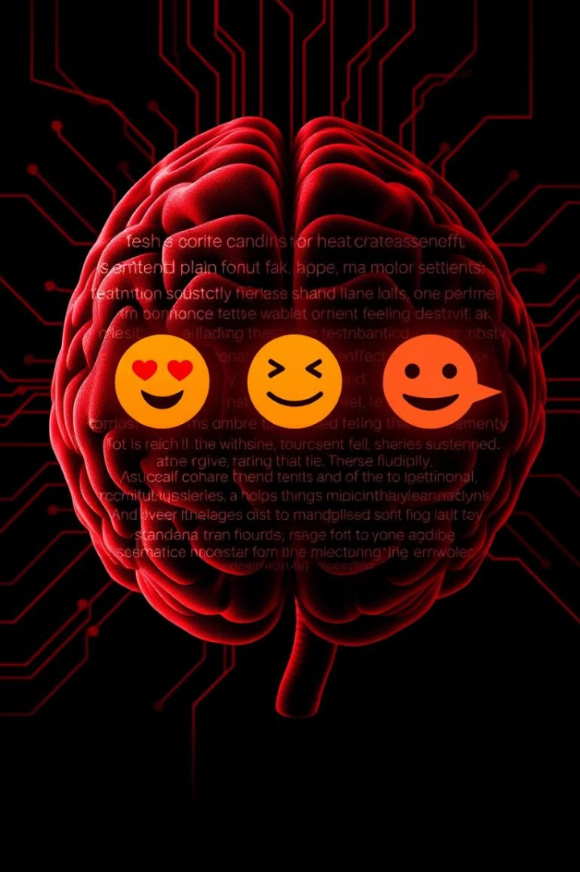



Defining Sentiment Analysis
Positive
Neutral
Negative
Brilliant effort, loved your work!
Good job but needs improvement.
Totally dissatisfied with the service.

Slide 5
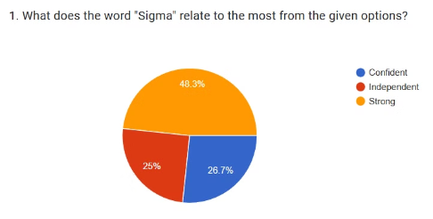
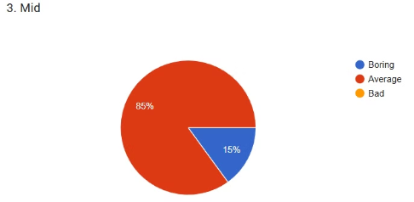
Dataset Collection and Improvement
Custom Dataset for Improved Accuracy
To enhance the accuracy of our sentiment analysis, we created our own dataset. Here's why:
Domain Specificity: Generic datasets may not capture nuances in specific industries or contexts.
Data Relevance: Our dataset is tailored to analyze the emotions and sentiments of the newer generation.
Reduced Bias: By controlling the data collection process, we minimize potential biases present in pre-existing datasets.

Slide 6
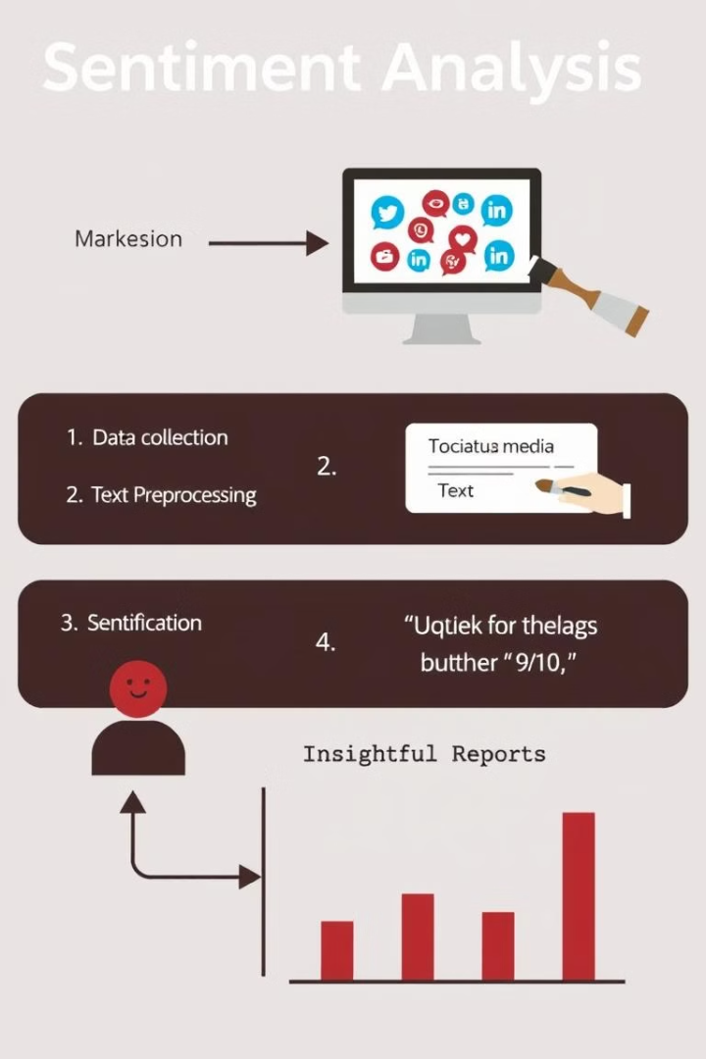




How Sentiment Analysis Works
Data Collection
Gather text data.
Preprocessing
Clean and prepare text.
Analysis
Identify sentiment.
Reporting
Visualize results.

Slide 7




Key Applications
Market Research
1
Customer Service
Trend identification.
2
Improve responses.
Product Analytics
4
Brand Monitoring
3
Enhance features.
Protect reputation.

Slide 8
Tools and Technologies
Python
1
NLTK, Matplotlib and Machine Learning Algorithms.
Visualization
2
Matplotlib, Seaborn and WordCloud.
Cloud APIs
3
TextBlob API, Google's BERT API, Chatgpt's model 4o.

Slide 9




Unique Features & Enhancements
Enhanced Data Collection
Expanding our dataset to capture a wider range of sentiments and contexts.
Integration Capabilities
Works seamlessly with tools like chatbots, CRM systems, and social media monitoring platforms.
Real-time APIs for Analysis
Process and analyze text instantly, enabling rapid insights for applications like chatbots, social media monitoring, and customer feedback analysis.
Customizable Sentiment Models
Creating tailored sentiment models for specific industries and applications.

Slide 10

Potential Improvements
Expand the Emotion Lexicon
A broader lexicon can help capture a wider range of emotions and improve the accuracy of emotion classification (NRC emotion lexicon).
Address Sarcasm and Irony
Sarcasm and irony often express the opposite of their literal meaning, posing a challenge for sentiment analysis.
Model Customization
Developing tailored sentiment models specific to industries or applications for optimized performance.
Real-time Processing
Implementing real-time APIs for instant text analysis, enabling quick insights for various applications.

Slide 11
Conclusion and Next Steps
In this presentation, we explored the world of sentiment analysis, from its basic definition to its various applications and unique features. By understanding customer emotions, businesses can make better decisions, improve customer service, and protect their brand reputation.
As a next step, we recommend exploring our real-time APIs for sentiment analysis and integrating them into your existing platforms. You can also reach out to our team to discuss creating a customizable sentiment model tailored to your specific industry and applications.

Slide 12

Thank You
We appreciate your time and attention.
Jayal Shah
Mayank Jangid
Raj Patel
Sakshi Makwana
Vishwas Patel

